Slide 1
Amazon - Sales Analysis
Raamya Pandey (BMAI-C-WD-E-B12)

Slide 2
CaseQuest Framework
Element | Details
Context | Analyze Amazon sales to understand trends, regional performance, and fulfillment patterns.
Analysis | Created Power BI visuals for revenue, orders, categories, regions, and fulfillment types.
Solution | Built interactive dashboard to monitor sales performance and highlight key drivers.
Execution | Business can focus on top-selling categories, optimize slow regions, and improve merchant fulfillment balance.

Slide 3
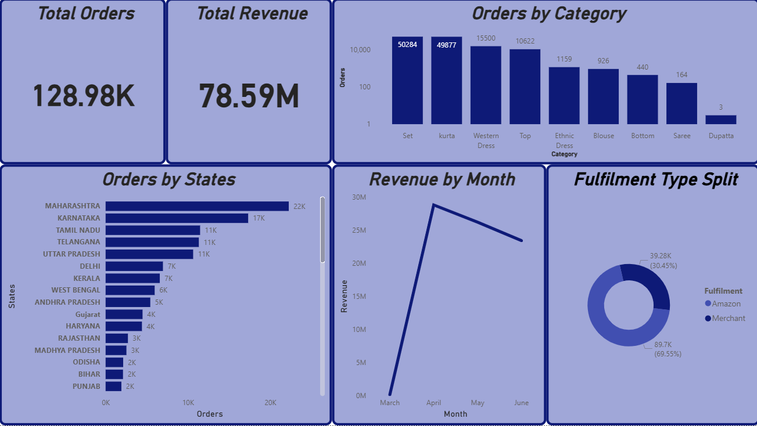
Dashboard Snapshot

Slide 4
Key Insights
💡 Insights:
Sets and Kurtas dominate sales, accounting for ~78% of orders.
Maharashtra, Karnataka, and Tamil Nadu are the top-performing states.
Revenue peaked in April, followed by a steady decline — may need marketing push or pricing review.
Merchant fulfilment handles ~70% of orders — Amazon can balance this for better delivery performance.

Slide 5
Business Recommendations
📌 Recommendations:
Double down on high-performing categories (Sets, Kurtas).
Optimize fulfilment split by increasing Amazon-handled orders in high-demand regions.
Launch geo-targeted promotions in top 5 states to maintain momentum.
Investigate revenue drop post-April — evaluate seasonality, pricing, or stock issues.

Slide 6
Thank You!!

